Slide 1
BUDGET SALES ANALYTICS
By Ayesha Fatima

Slide 2
Problem Statement
Extract various information such as Sales, budget, and variance. You can even compare sales
and budgets with various attributes. Extract necessary information about Products and
Customers. Make the necessary dashboard with the best you can extract from the data.
Use various visualization and features and make the best dashboard. Find key metrics and
factors and show the meaningful relationships between attributes.

Slide 3

Introduction:
I used Python for this project. First, I loaded the data, performed data cleaning, checked for missing values, and addressed them.
LIBRARIES USED ARE:
Pandas
Matplotlib
Numpy
Seaborn

Slide 4
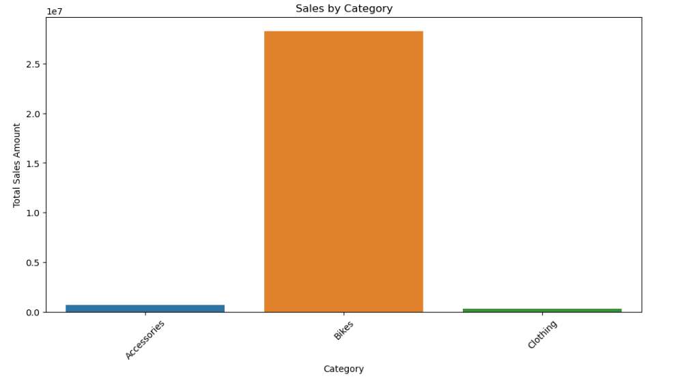
Insights
This visualization represents sales by category, with the 'Bikes' category at the top.

Slide 5
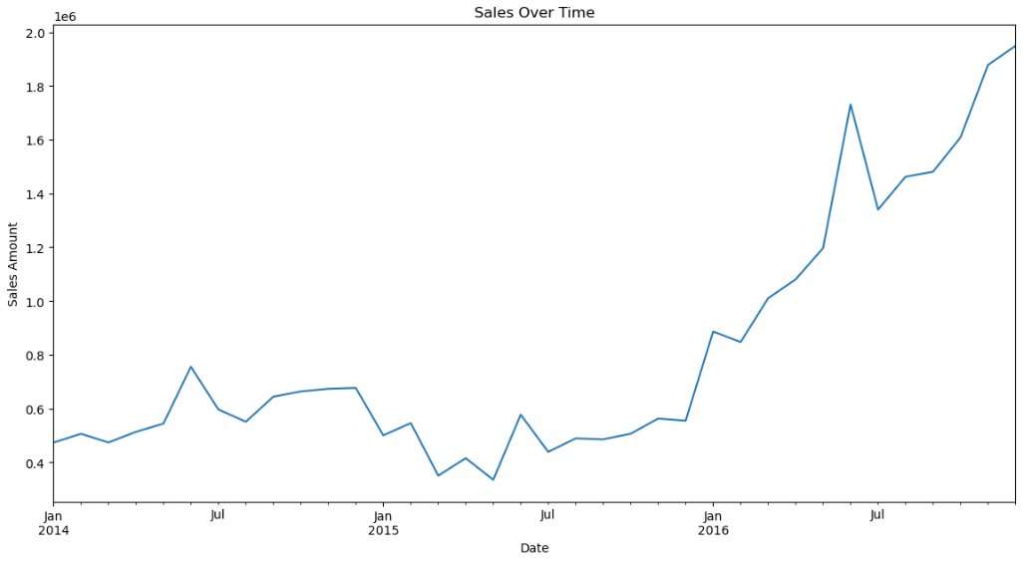
The second visualization represents a time series analysis, which shows that sales are gradually increasing over time.

Slide 6
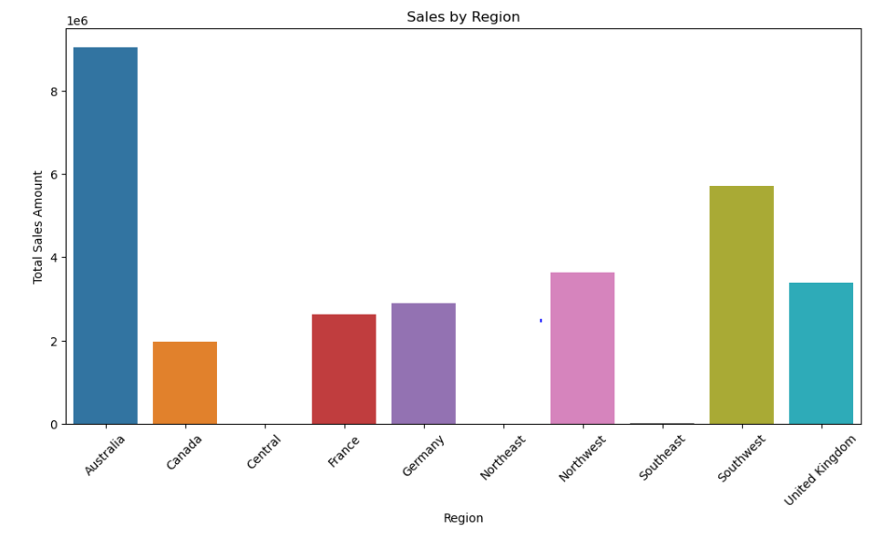
Here we have sales by country, with Australia leading in sales.

Slide 7
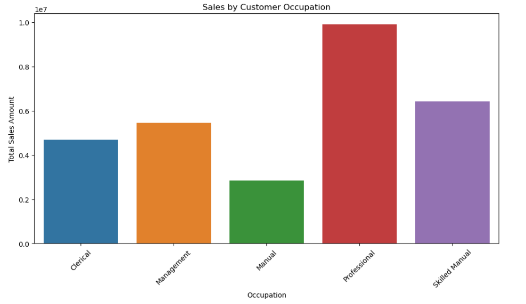
Sales by customer occupation

Slide 8
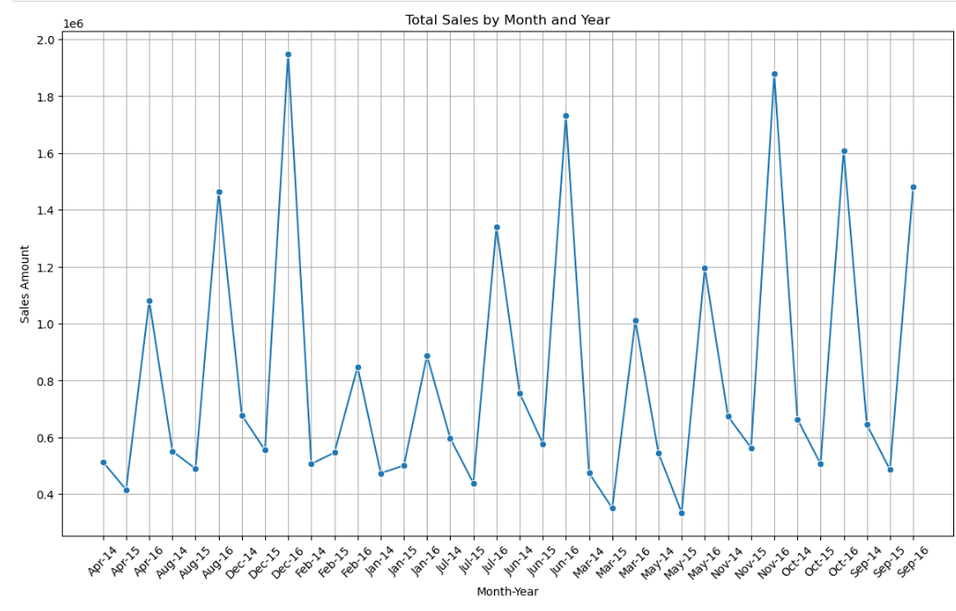
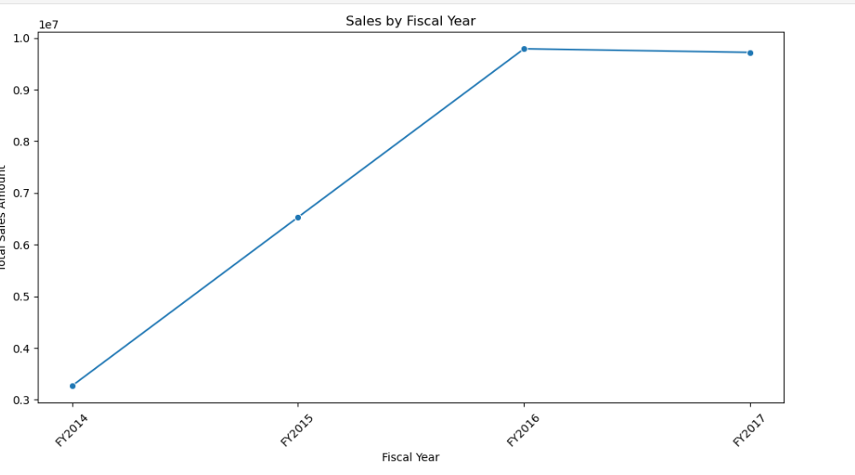

Slide 9
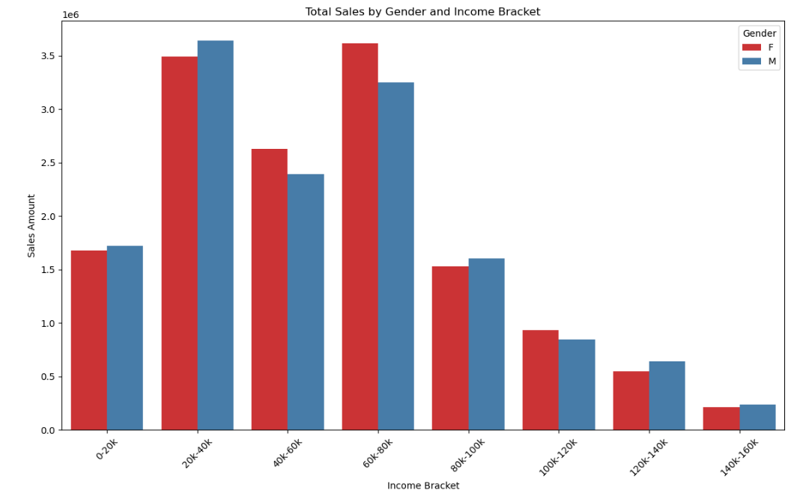

Slide 10
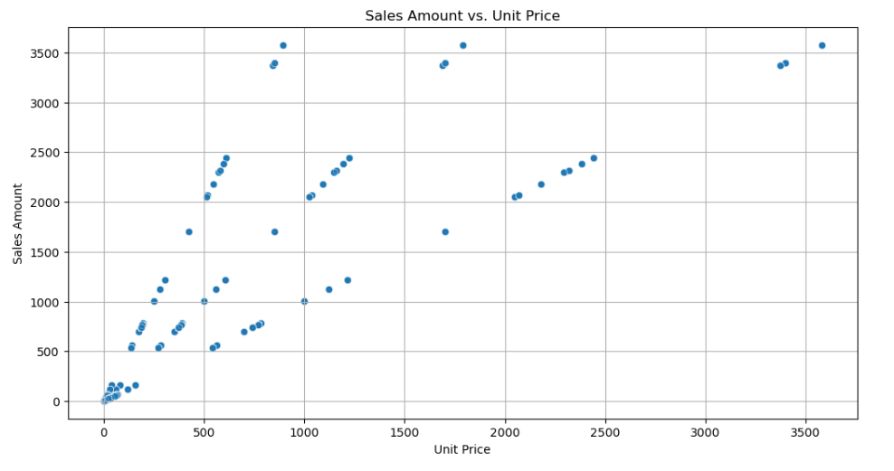

Slide 11
Conclusion:
From the report, I can conclude the following:
There is a notable relationship between product sales and customer demographics. In the road category, road and mountain bikes top the sales.
Customers without children tend to generate higher sales, possibly due to lower personal expenses. Therefore, the project should focus on targeting more of these customers.
The targeted audience is in their 50s, and sales tend to decline in January and February. This is partly because the budget for these months was lower, which led to decreased sales. The project should develop business strategies to address these slow months.
Sales are lowest in the sports product line.
A clear relationship between budget and sales is evident. The highest budgets are for mountain bikes ($5,257,897) and road bikes ($6,534,364), and these categories also show the highest sales. Conversely, the sports product line has the lowest sales, corresponding to its lower budget.

